Slide 1
Learning Objective: to understand what equipment a baby needs in the first year of

Slide 2
Starter
List as many pieces of equipment that you can that you think a baby would need.

Slide 3
Notes:
Parents budget and lifestyle will influence the choice of equipment. It is always important however, for new equipment to have safety labels, to be kept hygienic and for it to be checked regularly.

Slide 4
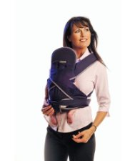
Baby slings
Notes:
These are strapped to the body allowing the child to be carried indoors and out, they will enjoy the close physical contact. Positions for the baby include front back or hip. They leave the hands free but should not be used whilst carrying out potentially dangerous activities eg cooking. Care should be taken to adjust the straps correctly, thus avoiding back strain. They are suitable from birth to 13kg.

Slide 5
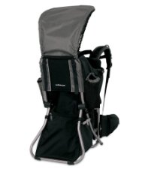
Back Carriers
Notes:
These are suitable for babies who can sit unaided are especially useful for outdoor use, the frame is made from lightweight metal and may have attachable bags, sun canopies or rain shields. As the name suggests they are carried on the back.

Slide 6
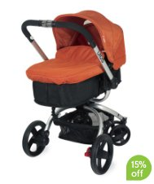
Prams, Pushchairs & Buggies
Notes:
The following criteria are important when choosing
Brakes
Suspensions
Sturdiness
Storage size
Ease of us
Weather resistance
New or second hand
Accessories available
Ease of pushing and steering
Versatility
Comfort
Ease of folding
Handle height
Weight
Tyres and wheels
Stability
Style and colour
Safety
Age range

Slide 7
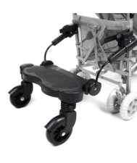
Buggy Boards
Notes:
These are sturdy platforms with out without small seats, which attach to buggies, prams and pushchairs so that toddlers can be transported.

Slide 8
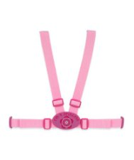
Walking reins
Notes:
Walking reins should be used for toddlers they assist in the control of energetic toddlers and prevent them from falling.

Slide 9
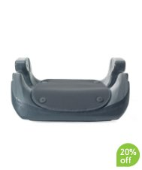
Car equipment
Notes:
Including
Sunshades
Seat belt adjuster
Booster seats
Seat belt cushions
Bottle and food warmers
Seat back protectors

Slide 10
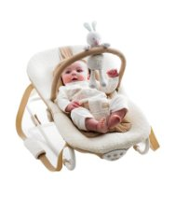
Bouncing cradle
Notes:
These are suitable for babies up to about 6 months who enjoy the movement they allow. They are easily transportable around the home and toys can be attached to them. They should only be used for short period of time and never placed anywhere other than the floor. Babies should never be left in them unattended.

Slide 11
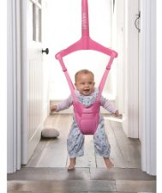
Baby Bouncer
Notes:
This fits in a doorway or stand allows babies to move their arms and legs freely. They can be used from approx 4 months until the baby can walk.

Slide 12
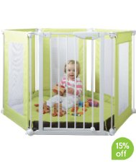
Play Pens
Notes:
These are available in different shapes and sizes. Because babies can see out of them they will usually play happily with toys or enjoy pulling themselves up and walking around the edge.

Slide 13
Reclining Chair
Are available for feeding infants

Slide 14
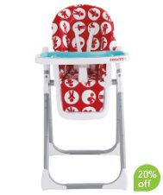
High Chair
Notes:
Can be used from abut 6 months when a baby can sit unaided.

Slide 15
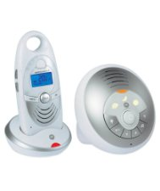
Baby Monitors
Notes:
These maintain contact between the parent and chid when they are not in the same room.

Slide 16
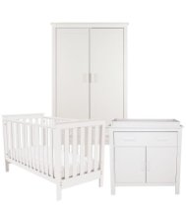
Cots
Notes:
These can be used from birth.

Slide 17
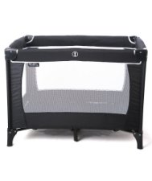
Travel Cots
Notes:
These are useful when visiting people or for holidays.

Slide 18
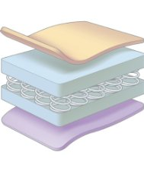
Other
Notes:
Pillows
Mattress
Blankets

Slide 19
Task
Create a collage of the pieces of equipment that you think a baby would need.
Make a note of the prices of these items as we will need them later

Slide 20
Homework - Exam Question
Suggest, with reasons, two points to consider when choosing each of these pieces of equipment.
Cot
Pram
Highchair
(6 marks)

