Slide 1
Starter – match em up
RAM
Optical drive
Processor / CPU
Spec (specification)
Hard Drive
The main memory where data and files are stored.
This is the ‘brain’ of the computer. This is the chip that computes all instructions and calculates and works with all the data.
This is a device that uses a laser to read disks. CD, DVD Drives and Blue ray.
A form of computer memory used when the computer is turned on. It wipe once the machine is turned off. This is used when you copy something and then paste it.
This is the full list of what the machine is made up of and what it is capable of. Includes the speed of processors, memory size and what types of drives it has.
Notes:
Write them down

Slide 2
What’s on the web?
What’s on the web – how shall I get on there?

Slide 3
Before you get onto the net – we need a machine...
When buying a computer:
You need to think about several things:
Its Features (What does it include?)
Its performance (What 2 things should I look for?)
Its connectivity (How can it connect?)
Give me some examples of what I should be looking for in a computer:
Notes:
Features:
Flat screen / LCD
Touchscreen
DVD/Blu Ray
Performance:
Processor
RAM
Battery life
Connectivity:
USB
Bluetooth
Wireless
HDMI

Slide 4
before we get onto the net...
You step into a shop to buy a laptop
You are going to look at 3 basic areas...
Features | Performance | Connectivity
What features does the device include? | What will you be looking for to get it working fast and smoothly? | What will we look for so that we can connect to internet and other devices?
1 | 1 | 1
2 | 2 | 2
3 | 3 | 3
4 | 4 | 4
Notes:
Features
A list of what the device includes.
e.g. DVD-RW, webcam, LCD flat screen, touch sensitive screen.
Performance
The speed of the processor or size of memory.
e.g. 2 GHz for speed or 4 GB for memory.
Connectivity
The range of interfaces it has for connecting to other devices.
e.g. USB, HDMI, Wi-Fi, Bluetooth.

Slide 5
Independent Activity
What is one the most important features that must be considered before buying a computer? (4)
The most important feature when buying a computer is...................The....enables the computer to do........This is important because.........

Slide 6
Learning Outcomes
Must be able to recognise components of a computer that contribute to its features, performance and connectivity.
Must recognise some of the hardware/software involved in getting online
Must be able to discuss the features, upsides and downsides of Netbooks and tablet computers to surf the web.

Slide 7
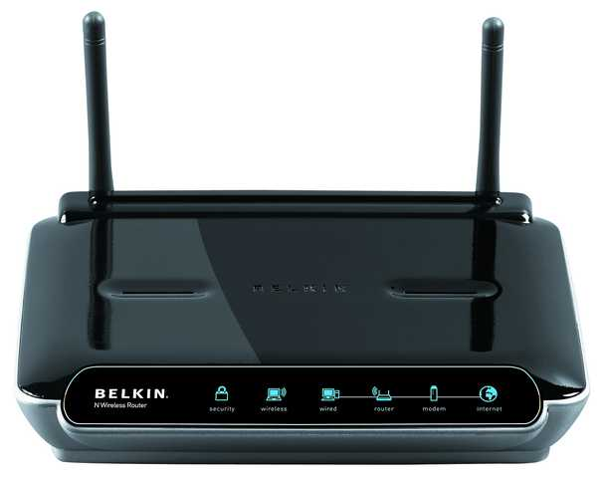
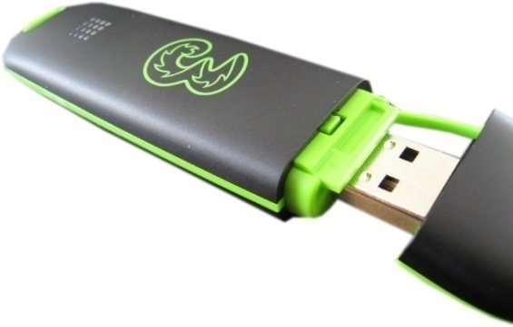
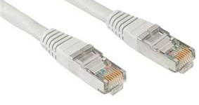
Getting online – Could you explain it to your Granny? Do you know the key terms?
Do you actually know how to get online? Do you know what each of them are and what they are and what they do?
Notes:
Router
Dongle

Slide 8
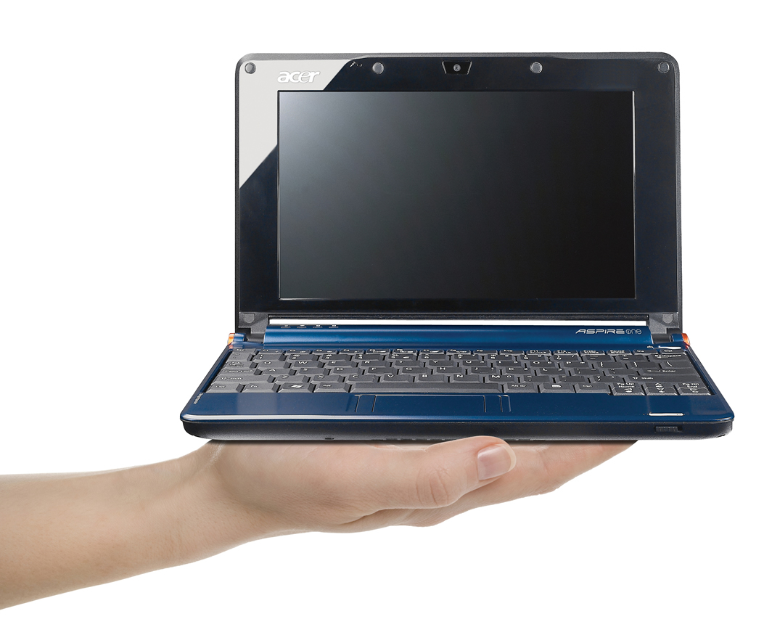
Research - Getting on the web...
What computer shall I use?
Netbooks
What makes a Netbook , a Netbook?
Why would I buy one?
What are they good for?
- Why might they not be very good for everyday use?

Slide 9
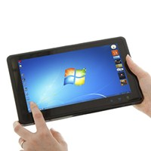
Research - Getting on the web...
What computer shall I use?
Tablet computers
What makes a tablet computer?
Why would I buy one?
What are they good for?
- Why might they not be very good for everyday use?

Slide 10
Discussion
How does the internet help in everyday life?
What web services are available to help?
Going to the bank
Shopping
Paying bills
Getting rid of junk around the house
Finding entertainment
Keeping up to date with news
Revise and study from home

Slide 11
Quick fire progress check
Name 1 way a computer can connect to a device
What type of cable is used for internet connection
What software is used to stop hackers accessing your computer
1 good feature of a netbook
1 downside to a netbook
1 good feature of a tablet computer
1 downside to a tablet computer
Name a web service that allows you:
To watch TV programmes
Revise from home
Pay bills (on sites such as ebay)

