Slide 1
“Revision” lesson
An exam in a lesson – getting 100%
Quick, quick, quick!

Slide 2
Some key words – what am I talking about?
Upload
Download
Rip
Store
Back up
Sync
Transfer

Slide 3
Questions straight from a paper
Work as fast as you can...
AIM:
TO GET FULL MARKS ON EXAM QUESTIONS
**(with a little bit of help)**
Sometimes stating the obvious is the best option!
Nailing the 2 marks and the 6 mark questions...

Slide 5
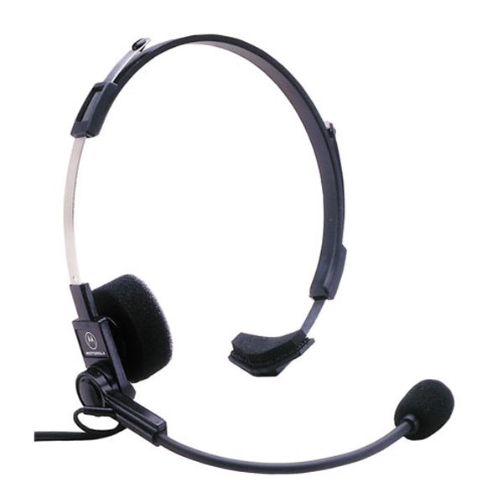
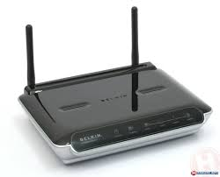
What can affect a
wireless signal?
Notes:
B
Any two from:
• interference
• physical block
• frequency overload
• distance from receiver

Slide 6
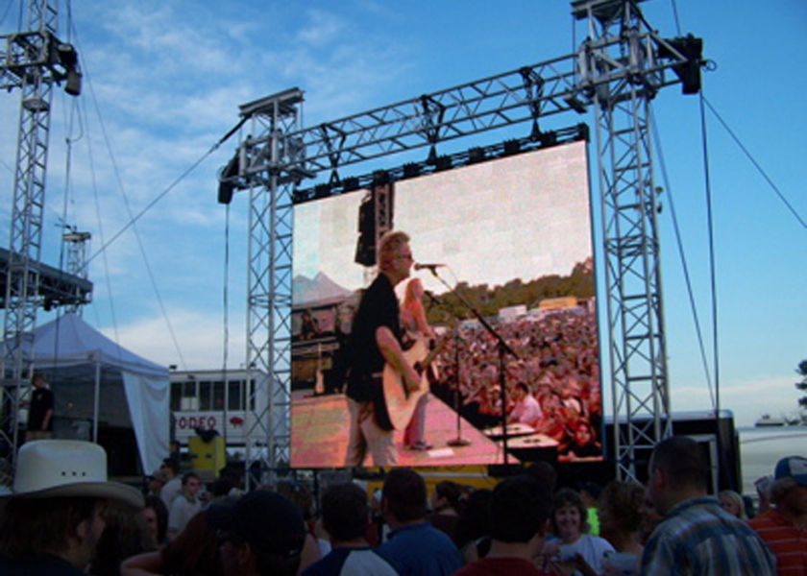
1. What actually happens when there is a delay in the signal?
2. What does that lead to at the concert?
Notes:
Images may be out of time with the sound/live
performance (1) and this gives a poor audience
experience (1)
Any two of:
• Blu-ray
• HD-DVD
• DVD
• CD
One student response from (d)(i) (e.g. Blu-ray) has
larger storage capacity (1) so can hold more data to
provide better quality sound (1)
Explanation to include two differences from:
• less data used to store audio information
• makes it quicker to download
• It is a popular format
• increases compatibility
Reduced audio quality / low quality / sound quality

Slide 7
What is the main difference
What does that mean?
Notes:
Any two of:
• Blu-ray
• HD-DVD
• DVD
• CD
One student response from (d)(i) (e.g. Blu-ray) has
larger storage capacity (1) so can hold more data to
provide better quality sound (1)

Slide 8
What is the main feature of an Mp3 compared to a CD?
Why is it suitable for the internet?
Notes:
Explanation to include two differences from:
• less data used to store audio information
• makes it quicker to download
• It is a popular format
• increases compatibility
Reduced audio quality / low quality / sound quality

Slide 9
Think of three good
things about downloads?
Think of three problems
about downloads?
Pros | Cons
1 mark for each
Notes:
Accessibility
• Consumers need particular (format compatible) devices to listen, which limits the market for the band (unless they
provide for a range of formats).
• 24x7x365 access to music.
• Digital divide (access dependent on internet access and digital literacy).
• Understand and use range of formats / incompatibility.
Copyright and piracy
• DRM reduces opportunity for consumers to share files / can limit storage of files to certain (numbers of) devices.
• DRM helps protect musicians’ revenue.
• Consumers must abide by new laws (Digital Economy Act 2010).
• Downloadable content is more easily shared than physical products.
• Musicians may rely more on other revenue (subscriptions / concerts etc).
Variety
• Musicians may create more popular music (that sells in higher volumes) due to reduced sales caused by piracy.
• Only certain labels / artists distribute online.
Revenue/Marketing
• Different style of advertising required for downloads.
• Musicians may/can choose to be independent by self promote / break from publishers.
• Payment systems and/or payment technologies.
General / Personal preference
• Need software and hardware to listen back to music.
• Download does not have same ‘feel’ as material product.
• Sound quality: some people prefer sound of vinyl

Slide 10
Some key words – what am I talking about?
Phishing
Pharming
Spam
Netbot

Slide 11
What is the main difference between DVD and Blu Ray?
Why is it not suitable for a DVD player?
Notes:
B
Any two explanation points from:
• Discs use different formats
• Not compatible
• Unable to be read
• Blu-ray uses a different laser
=

Slide 12
1. What is the main reason to protect the disc?
2. What does that mean to the artist?
Notes:
Modem / Ethernet cable / (Wireless) dongle /
(Wireless) Router / Wireless adapter
Explanation:
To stop the media from being shared / copied
and sold illegally / prevent it being ripped. (1)
This helps protect the rights/revenue of the
copyright owner. (1)

Slide 13
1. What is likely to be the content of these emails?
2. How can they be more personal?
Notes:
To improve Laura’s experience (1) by increasing the
relevance of the adverts (1)
1 mark (max) may be awarded for:
• Laura has opted in to receive emails from the
company (or not opted out) (1)
or,
• reference to an organisation’s marketing strategy (1)
or,
• answers relating to: persuading her to buy more (1)

Slide 14
1. What kind of data is collected?
2. What can they now start doing with this info?
Notes:
Description:
The online shop have stored/tracked data from her previous
transactions (1) and matched that data with other items for
sale (1).
Any two from:
• Contact the sender to opt out / unsubscribe
• Filter her emails / block sender / mark address as
spam
• Change her email address
• Deactivate her email account

Slide 15
Indicates it is negative
What implications are there to using online accounts?
GPS?
What can your ISP find out about you?
Who might be watching you?
What might someone do with all
Your personal details?
What can be gained from
Social Network sites?
Your personal data?
What legislation exists?
How easy is it to get rid of stuff
Once its online?
What happens when info is on the internet?
1 mark for each
Notes:
Data collection and use:
(Covert)
• Online companies gathering statistics about users’ searches and browsing habits actions for marketing purposes.
• Cookie installation and spyware
• ISPs are able to view data that pass through them.
• Government / Police looking at individuals’ computers without a warrant. (Big Brother concept)
• Identity theft
(Overt)
• Filling out forms / buying goods. Users provide personal data knowingly without realising implications
• Requirements for users to ‘opt in’ to gain access to services
• Complicated ‘opt out’ methods.
• Privacy policies
Social (networking) concerns
• Personal information made available to all in social network.
• GPS tools now provide means to publish individual’s location
• Individuals may appear in media when they are not aware. (eg photos/videos on social media or Google’s “Street view”
service)
• Users need to be mindful what they look at online. Fear of social ‘control’.
• Vulnerable (at risk) groups face an increased threat.
Legal issues:
• Difficult to enforce the Data Protection Act

Slide 16
• Consumers need particular (format compatible) devices to listen, which limits the market for the band (unless they
provide for a range of formats).
• 24x7x365 access to music.
• Digital divide (access dependent on internet access and digital literacy).
• Understand and use range of formats / incompatibility.
Copyright and piracy
• DRM reduces opportunity for consumers to share files / can limit storage of files to certain (numbers of) devices.
• DRM helps protect musicians’ revenue.
• Consumers must abide by new laws (Digital Economy Act 2010).
• Downloadable content is more easily shared than physical products.
• Musicians may rely more on other revenue (subscriptions / concerts etc).
Variety
• Musicians may create more popular music (that sells in higher volumes) due to reduced sales caused by piracy.
• Only certain labels / artists distribute online.
Revenue/Marketing
• Different style of advertising required for downloads.
• Musicians may/can choose to be independent by self promote / break from publishers.
• Payment systems and/or payment technologies.
General / Personal preference
• Need software and hardware to listen back to music.
• Download does not have same ‘feel’ as material product.
• Sound quality: some people prefer sound of vinyl
Notes:
Accessibility
• Consumers need particular (format compatible) devices to listen, which limits the market for the band (unless they
provide for a range of formats).
• 24x7x365 access to music.
• Digital divide (access dependent on internet access and digital literacy).
• Understand and use range of formats / incompatibility.
Copyright and piracy
• DRM reduces opportunity for consumers to share files / can limit storage of files to certain (numbers of) devices.
• DRM helps protect musicians’ revenue.
• Consumers must abide by new laws (Digital Economy Act 2010).
• Downloadable content is more easily shared than physical products.
• Musicians may rely more on other revenue (subscriptions / concerts etc).
Variety
• Musicians may create more popular music (that sells in higher volumes) due to reduced sales caused by piracy.
• Only certain labels / artists distribute online.
Revenue/Marketing
• Different style of advertising required for downloads.
• Musicians may/can choose to be independent by self promote / break from publishers.
• Payment systems and/or payment technologies.
General / Personal preference
• Need software and hardware to listen back to music.
• Download does not have same ‘feel’ as material product.
• Sound quality: some people prefer sound of vinyl

Slide 17
???
Did you score the maximum marks?

Slide 18
Notes:
B

Slide 19
Any two from:
• interference
• physical block
• frequency overload
• distance from receiver
Notes:
Any two from:
• interference
• physical block
• frequency overload
• distance from receiver

Slide 20
1. What actually happens when there is a delay in the signal?
2. What does that lead to at the concert?
Images may be out of time with the sound/live
performance (1) and this gives a poor audience
experience (1)
Notes:
Any two of:
• Blu-ray
• HD-DVD
• DVD
• CD
One student response from (d)(i) (e.g. Blu-ray) has
larger storage capacity (1) so can hold more data to
provide better quality sound (1)
Explanation to include two differences from:
• less data used to store audio information
• makes it quicker to download
• It is a popular format
• increases compatibility
Reduced audio quality / low quality / sound quality

Slide 21
Any two of:
• Blu-ray
• HD-DVD
• DVD
• CD
One student response from (d)(i) (e.g. Blu-ray) has larger storage capacity (1) so can hold more data to provide better quality sound (1)
What is the main difference
What does that mean?

Slide 22
Explanation to include two differences from:
• less data used to store audio information
• makes it quicker to download
• It is a popular format
• increases compatibility
Reduced audio quality / low quality / sound quality
What is the main feature of an Mp3 compared to a CD?
Why is it suitable for the internet?

Slide 23
Think of three good
things about downloads?
Think of three problems
about downloads?
Pros | Cons
1 mark for each
Notes:
Accessibility
• Consumers need particular (format compatible) devices to listen, which limits the market for the band (unless they
provide for a range of formats).
• 24x7x365 access to music.
• Digital divide (access dependent on internet access and digital literacy).
• Understand and use range of formats / incompatibility.
Copyright and piracy
• DRM reduces opportunity for consumers to share files / can limit storage of files to certain (numbers of) devices.
• DRM helps protect musicians’ revenue.
• Consumers must abide by new laws (Digital Economy Act 2010).
• Downloadable content is more easily shared than physical products.
• Musicians may rely more on other revenue (subscriptions / concerts etc).
Variety
• Musicians may create more popular music (that sells in higher volumes) due to reduced sales caused by piracy.
• Only certain labels / artists distribute online.
Revenue/Marketing
• Different style of advertising required for downloads.
• Musicians may/can choose to be independent by self promote / break from publishers.
• Payment systems and/or payment technologies.
General / Personal preference
• Need software and hardware to listen back to music.
• Download does not have same ‘feel’ as material product.
• Sound quality: some people prefer sound of vinyl

Slide 24
• Consumers need particular (format compatible) devices to listen, which limits the market for the band (unless they
provide for a range of formats).
• 24x7x365 access to music.
• Digital divide (access dependent on internet access and digital literacy).
• Understand and use range of formats / incompatibility.
Copyright and piracy
• DRM reduces opportunity for consumers to share files / can limit storage of files to certain (numbers of) devices.
• DRM helps protect musicians’ revenue.
• Consumers must abide by new laws (Digital Economy Act 2010).
• Downloadable content is more easily shared than physical products.
• Musicians may rely more on other revenue (subscriptions / concerts etc).
Variety
• Musicians may create more popular music (that sells in higher volumes) due to reduced sales caused by piracy.
• Only certain labels / artists distribute online.
Revenue/Marketing
• Different style of advertising required for downloads.
• Musicians may/can choose to be independent by self promote / break from publishers.
• Payment systems and/or payment technologies.
General / Personal preference
• Need software and hardware to listen back to music.
• Download does not have same ‘feel’ as material product.
• Sound quality: some people prefer sound of vinyl
Notes:
Accessibility
• Consumers need particular (format compatible) devices to listen, which limits the market for the band (unless they
provide for a range of formats).
• 24x7x365 access to music.
• Digital divide (access dependent on internet access and digital literacy).
• Understand and use range of formats / incompatibility.
Copyright and piracy
• DRM reduces opportunity for consumers to share files / can limit storage of files to certain (numbers of) devices.
• DRM helps protect musicians’ revenue.
• Consumers must abide by new laws (Digital Economy Act 2010).
• Downloadable content is more easily shared than physical products.
• Musicians may rely more on other revenue (subscriptions / concerts etc).
Variety
• Musicians may create more popular music (that sells in higher volumes) due to reduced sales caused by piracy.
• Only certain labels / artists distribute online.
Revenue/Marketing
• Different style of advertising required for downloads.
• Musicians may/can choose to be independent by self promote / break from publishers.
• Payment systems and/or payment technologies.
General / Personal preference
• Need software and hardware to listen back to music.
• Download does not have same ‘feel’ as material product.
• Sound quality: some people prefer sound of vinyl

Slide 25
Any two explanation points from:
• Discs use different formats
• Not compatible
• Unable to be read
• Blu-ray uses a different laser
What is the main difference between DVD and Blu Ray?
Why is it not suitable for a DVD player?
Notes:
B
=

Slide 26
Modem / Ethernet cable / (Wireless) dongle /
(Wireless) Router / Wireless adapter
Explanation:
To stop the media from being shared / copied
and sold illegally / prevent it being ripped. (1)
This helps protect the rights/revenue of the
copyright owner. (1)
1. What is the main reason to protect the disc?
2. What does that mean to the artist?
Notes:
Modem / Ethernet cable / (Wireless) dongle /
(Wireless) Router / Wireless adapter
Explanation:
To stop the media from being shared / copied
and sold illegally / prevent it being ripped. (1)
This helps protect the rights/revenue of the
copyright owner. (1)

Slide 27
To improve Laura’s experience (1) by increasing the
relevance of the adverts (1)
1 mark (max) may be awarded for:
• Laura has opted in to receive emails from the
company (or not opted out) (1)
or,
• reference to an organisation’s marketing strategy (1)
or,
• answers relating to: persuading her to buy more (1)
1. What is likely to be the content of these emails?
2. How can they be more personal?
Notes:
To improve Laura’s experience (1) by increasing the
relevance of the adverts (1)
1 mark (max) may be awarded for:
• Laura has opted in to receive emails from the
company (or not opted out) (1)
or,
• reference to an organisation’s marketing strategy (1)
or,
• answers relating to: persuading her to buy more (1)

Slide 28
Description:
The online shop have stored/tracked data from her previous
transactions (1) and matched that data with other items for
sale (1).
1. What kind of data is collected?
2. What can they now start doing with this info?
Any two from:
• Contact the sender to opt out / unsubscribe
• Filter her emails / block sender / mark address as
spam
• Change her email address
• Deactivate her email account
Notes:
Description:
The online shop have stored/tracked data from her previous
transactions (1) and matched that data with other items for
sale (1).
Any two from:
• Contact the sender to opt out / unsubscribe
• Filter her emails / block sender / mark address as
spam
• Change her email address
• Deactivate her email account

Slide 29
Indicates it is negative
What implications are there to using online accounts?
GPS?
What can your ISP find out about you?
Who might be watching you?
What might someone do with all
Your personal details?
What can be gained from
Social Network sites?
Your personal data?
What legislation exists?
How easy is it to get rid of stuff
Once its online?
What happens when info is on the internet?
1 mark for each
Notes:
Data collection and use:
(Covert)
• Online companies gathering statistics about users’ searches and browsing habits actions for marketing purposes.
• Cookie installation and spyware
• ISPs are able to view data that pass through them.
• Government / Police looking at individuals’ computers without a warrant. (Big Brother concept)
• Identity theft
(Overt)
• Filling out forms / buying goods. Users provide personal data knowingly without realising implications
• Requirements for users to ‘opt in’ to gain access to services
• Complicated ‘opt out’ methods.
• Privacy policies
Social (networking) concerns
• Personal information made available to all in social network.
• GPS tools now provide means to publish individual’s location
• Individuals may appear in media when they are not aware. (eg photos/videos on social media or Google’s “Street view”
service)
• Users need to be mindful what they look at online. Fear of social ‘control’.
• Vulnerable (at risk) groups face an increased threat.
Legal issues:
• Difficult to enforce the Data Protection Act

Slide 30
Data collection and use:
(Covert)
• Online companies gathering statistics about users’ searches and browsing habits actions for marketing purposes.
• Cookie installation and spyware
• ISPs are able to view data that pass through them.
• Government / Police looking at individuals’ computers without a warrant. (Big Brother concept)
• Identity theft
(Overt)
• Filling out forms / buying goods. Users provide personal data knowingly without realising implications
• Requirements for users to ‘opt in’ to gain access to services
• Complicated ‘opt out’ methods.
• Privacy policies
Social (networking) concerns
• Personal information made available to all in social network.
• GPS tools now provide means to publish individual’s location
• Individuals may appear in media when they are not aware. (eg photos/videos on social media or Google’s “Street view”
service)
• Users need to be mindful what they look at online. Fear of social ‘control’.
• Vulnerable (at risk) groups face an increased threat.
Legal issues:
• Difficult to enforce the Data Protection Act
Notes:
Data collection and use:
(Covert)
• Online companies gathering statistics about users’ searches and browsing habits actions for marketing purposes.
• Cookie installation and spyware
• ISPs are able to view data that pass through them.
• Government / Police looking at individuals’ computers without a warrant. (Big Brother concept)
• Identity theft
(Overt)
• Filling out forms / buying goods. Users provide personal data knowingly without realising implications
• Requirements for users to ‘opt in’ to gain access to services
• Complicated ‘opt out’ methods.
• Privacy policies
Social (networking) concerns
• Personal information made available to all in social network.
• GPS tools now provide means to publish individual’s location
• Individuals may appear in media when they are not aware. (eg photos/videos on social media or Google’s “Street view”
service)
• Users need to be mindful what they look at online. Fear of social ‘control’.
• Vulnerable (at risk) groups face an increased threat.
Legal issues:
• Difficult to enforce the Data Protection Act

Slide 31
How many marks:
U | G | F | E | D | C | B | A | A*
4 | 7 | 11 | 14 | 18 | 22 | 25 | 29 | 32

