Slide 1
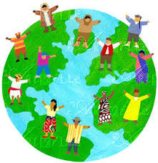
Culture & Parenthood

Slide 2
Lesson Outcomes
All students will be able to list some variations of culture
Most will be able to discuss the meaning of a multi cultural society
Some will be able to determine how culture may vary when parenting

Slide 3
In pairs – define the term CULTURE – what do you think it means?
A CULTURE is a set of norms, beliefs and values that belong to a group, which makes them different from other groups.

Slide 4
Task
Create a thought shower in your book. What signs of different culture can you list?

Slide 5
Did you have these?
Music
Size of the family
Religion
Signs of different culture
Lifestyle
Clothing
Language
Traditions and celebrations
Food and eating habits

Slide 6
Question
Now you know what culture is. How would you explain the term
‘Multi cultural society?’
Discuss

Slide 7
Multi cultural society
Britain is a multi cultural society. That is it is made up of many different ethnic groups, whose countries of origin may have very different cultures

Slide 8
Task - leaflet
You are to create a leaflet for a health visitor to inform them about one chosen ethnic group.
The leaflet needs to include information on the following:
Foods
Traditions and celebrations
Men and women's roles
Religion
Lifestyle
Language
Notes:
Give students a culture to research

Slide 9
Progress Check
Feedback – what information do you have on cultures and food?

Slide 10
Task - leaflet
You are to create a leaflet for a health visitor to inform them about one chosen ethnic group.
The leaflet needs to include information on the following:
Foods
Traditions and celebrations
Men and women's roles
Religion
Lifestyle
Language
Notes:
Give students a culture to research

Slide 11
Progress Check
Feedback – what information do you have on cultures and traditions?

Slide 12
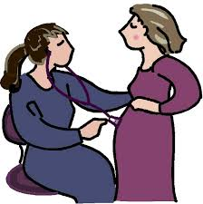
Plenary
Why do you think that a health visitor or midwife would need information about a persons culture?
How would this information affect how they did their job?

