Slide 1
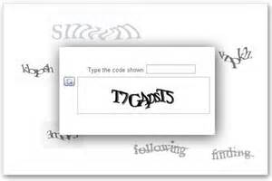
Starter – why?
Card Number
**** **** **** ****

Slide 2
Online Goods and Services 3
Theory revision
You will complete the activities in this PowerPoint and use the revision book to answer questions.

Slide 3
Simple brain storm...ideas
How can you pay for goods online?
Credit card
Debit card
Third party payment process – paypal
Online coupons
Gift vouchers
Evouchers

Slide 4
Straight in there!
Pages 49 and 50
Some payment revision...10 mins
Notes:
Credit card
Debit card
Third party payment process – paypal
Online coupons
Gift vouchers
Evouchers

Slide 5
Lesson outcomes
All will be to list ways to pay for goods online.
All will revise topics surrounding payment online. (A to F)
Most will be able to discuss the issues surrounding advertising on the internet. (D to A)
All will be able to state what Viral Marketing is.
Some will be able to explain how viral marketing works.

Slide 6
Question
How many of you have got a smart phone?
How many times a day do you go onto the net?
How many of you read a newspaper?
How many of you have a regular magazine you subscribe to?
Notes:
Now think globally...

Slide 7
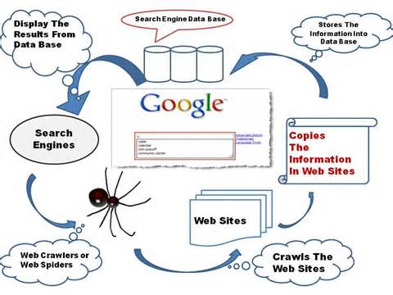
How does a search engine work?
Notes:
Key words or key phrases are used

Slide 8
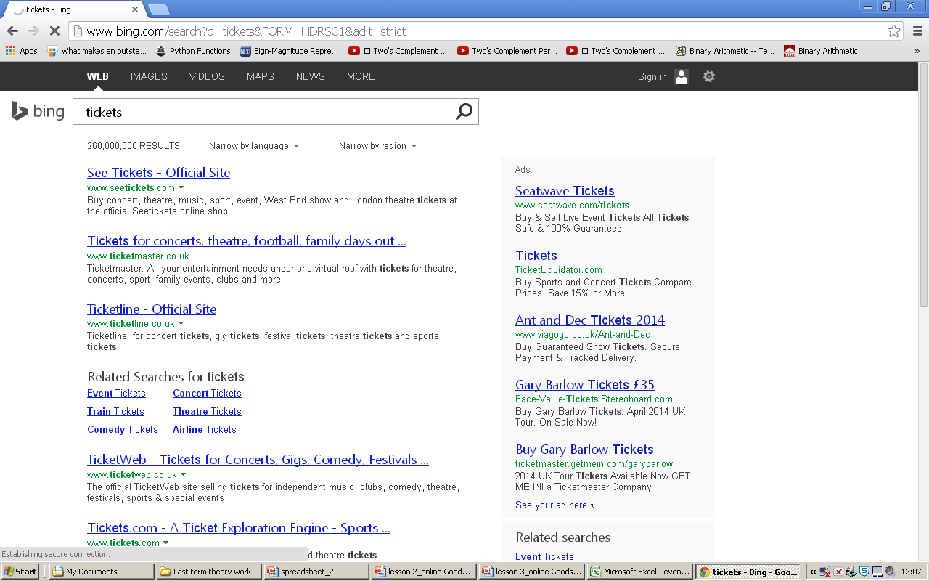
But did you know?
How do some pages get to the top of the list?
Pay for it!
Notes:
Companies pay for the for this optimisation...
It can also be based on how many links there are to your site.
Web optimisations...

Slide 9
Quick question?
How does facebook know what adverts to target you with?
Using settings and preferences
Notes:
Companies pay for the for this optimisation...
It can also be based on how many links there are to your site.
Web optimisations...

Slide 10
Question time:
Page 46...Internet advertising 1

Slide 11
Interlude
What is meant by Viral Advertising
Lets come up with a definition:
What are the most popular and most seen viral videos?

Slide 12
Targeted question
Page 47 – (c) Describe how Mixup might use targeted marketing to promote their album.
Where could they get data from?
Transactional data
Data from apps
Social networking sites = profiles
Cookies
Account information

Slide 13
Straight in there!
Pages 47 and 48
Some online goods/services revision...10 mins

