Slide 1
Look no hands!
Living in a world where we don’t need passwords or pin numbers

Slide 2
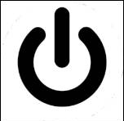
Guess!

Slide 3
Lesson outcomes
All students will be able explain the meaning of the biometrics and suggest uses for it.
Most students will be explain how NFC works and explain the advantages and disadvantages of the system.
All will revise topics to do with e-commerce

Slide 4
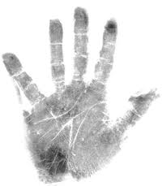
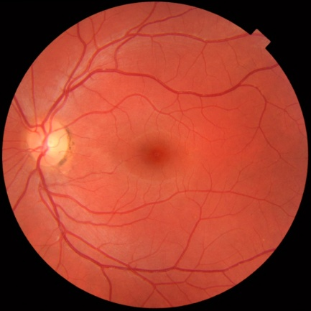
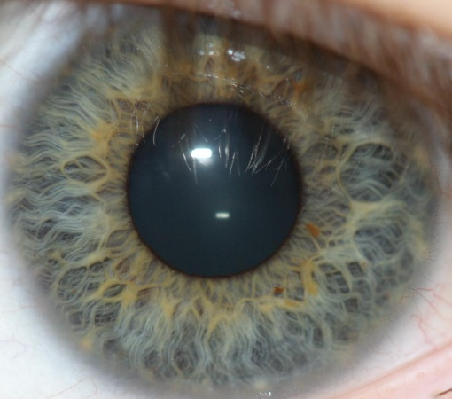
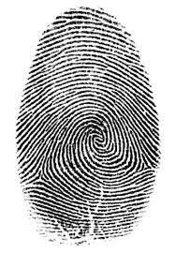
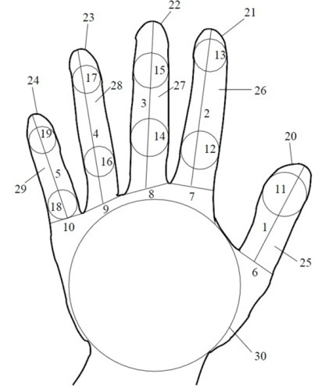
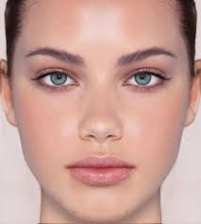
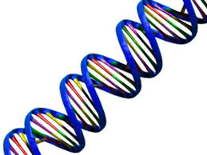
What have these got in common?
Ways you could be recognised!
Notes:
You can be recognised by them

Slide 5
Funny but...
First clip
Which of these cannot be used to identify someone or something?
Skin
Voice recognition
Hair
fingerprint
Face recognition
iris
Retina
Smell
DNA
Breath
The way you type
Your walk
Hand writing
Mucus
Notes:
http://www.youtube.com/watch?v=rGnnNj8l7pI - Monsters Vs Aliens

Slide 6
In practice – Do you know its being used?
Surveillance: Did you know this existed?
In future (science fiction) – Minority Report
How far away are we from this?
Notes:
Where would you find it?
Lakeside?
City centres?
Airports?

Slide 7
Biometrics
Lets come up with a definition:
Biometrics (or biometric authentication)refers to the identification of humans by their characteristics or traits.
Notes:
Biometrics (or biometric authentication)^{[note 1]} refers to the identification of humans by their characteristics or traits.

Slide 8
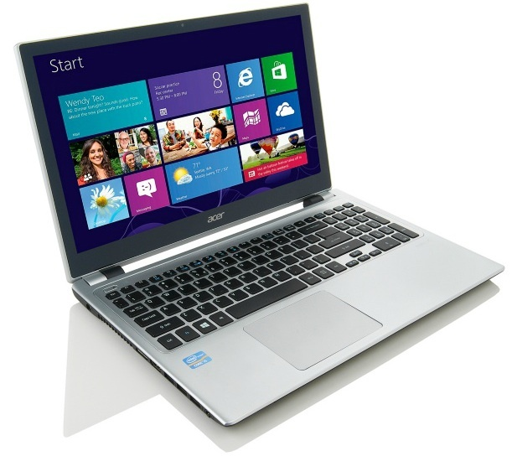
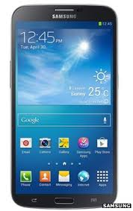
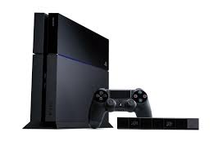
Handy things everyday...
Does your tech use any of these biometrics methods?
Notes:
Eye sensor – lock screen
Voice recognition
Facial recognition
Finger print
Wake up

Slide 9
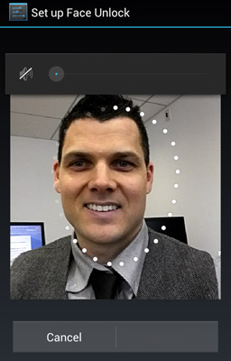
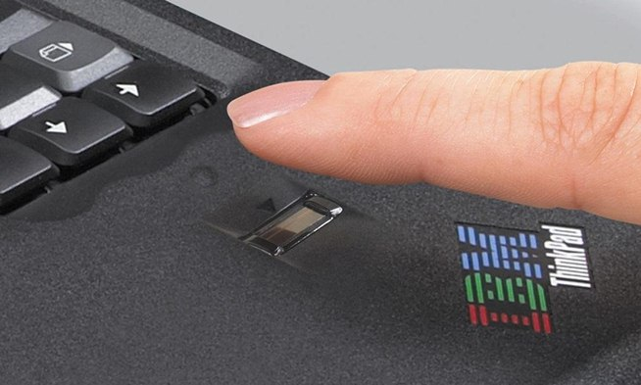
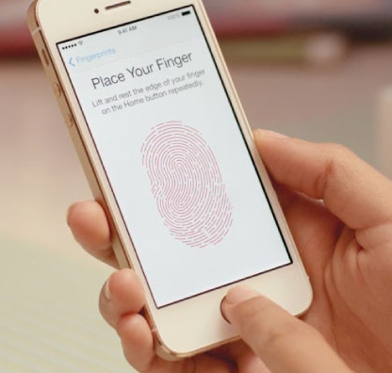
Handy things everyday...
Voice?
Does your tech use biometrics?
Face?
Logging on
Without
Passwords?
Notes:
Eye sensor – lock screen
Voice recognition
Facial recognition
Finger print
Wake up

Slide 10
Super Quick questions (copy the question)
Suggest some (3) places that could make use of facial recognition technology.
Think of a way biometric technology could be used in school.
Suggest some (3) ways in which biometric identification can be used in hand held devices.

Slide 11
Question:
Biometrics ID is more and more common place: Discuss the good + bad sides and decide on whether you agree or disagree with its use.
Possible framework
The benefits of biometric identification are:
The downsides that I see of this technology is that:
Looking at the positive and negative, I believe it is...(explain why)
however

Slide 12
Quick brainstorm:
Good things
Bad things

Slide 13
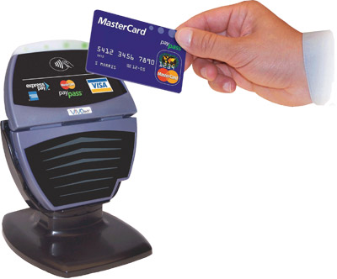
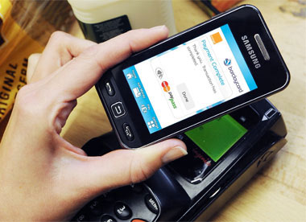
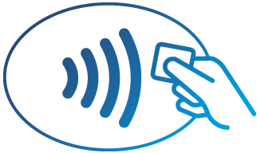
Contactless Payment
Biometrics mean that you can ID someone without meeting / touching / needing a password.
Remember this advert

Slide 14
NFC or Near field communication
Quick questions:
What problems can you see with this technology?
What restrictions are there?
What good things are there about this technology?

Slide 15
Question: literacy task
Does it make sense?
Is it factually accurate or is it just general sweeping statements?
Can you see spelling errors?
Have they for?
Have they against?
Have they come up with their own view?

