Slide 1
Computer Science vs ICT
What’s the difference?

Slide 2
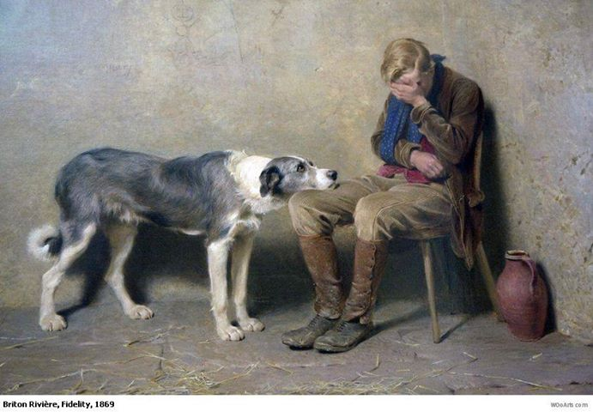
Starter – Is this a good painting?
Notes:
This is my favourite painting – what do you think?
How would a computer think about this?
How, why?

Slide 3
From last lesson: What kind of decisions do computers make?
Notes:
Boolean...

Slide 4
Objectives
All Will understand the process of problem solving and the “Algorithm”
Some of you will create algorithms that could be used to solve problems.
All will understand the difference between ICT and Computing.

Slide 5
Computer science has a lot to do with psychology
A computer is built like a human brain:
We go through a certain set of processes in order to complete a task.
Its good practice to break down the thought process in order to program a computer to do a job.
Tiny little decisions, questions, combine to create a process....for example:

Slide 6
Simple process: Think of the process involved with eating and drinking.
Do I like it?
Have I eaten this before?
Am I hungry?
What do I want to eat?
Does it look nice?
How do I know?
What is available?
Am I thirsty?
Do I fancy it right now?
Stomach rumbling?
What can I afford?
Is it enough?
When can I eat/drink again?
Is it healthy?
Do I have enough energy?
IS it too much?
Should I save some?
Am I allergic?
Am I feeling weak?
Too sweet?
Am I eating too much?
Do I need something else?
Too salty?
Too sour?
Should I lay off
Too hot/cold?
Notes:
These are a tiny fraction of the processes involved with our brains computing the complexities of eating and drinking. We may do all these things in a split second

Slide 7
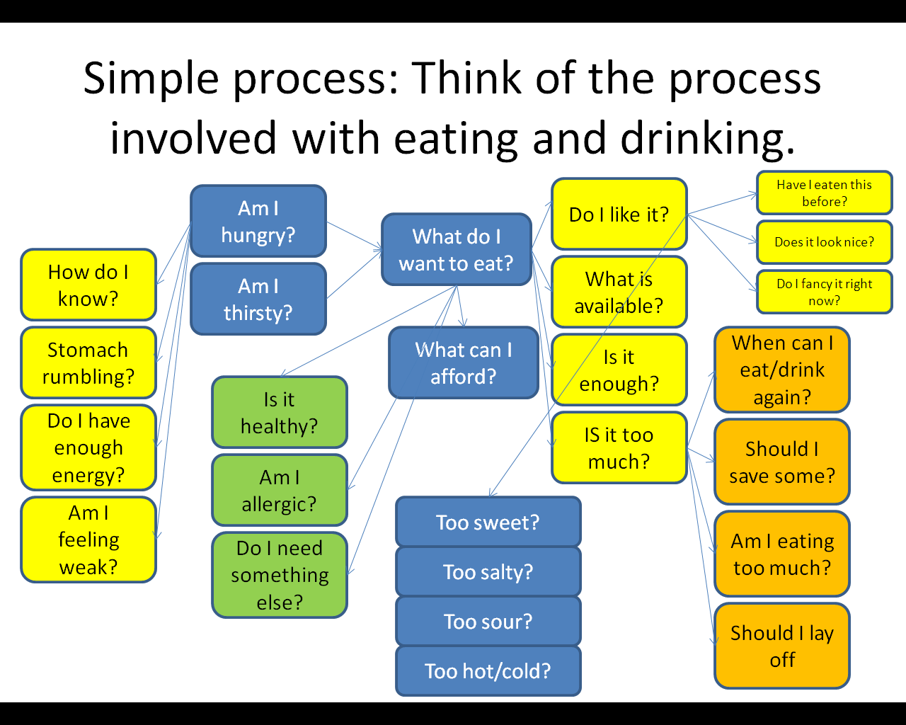
Simple process: Think of the process involved with eating and drinking.
The problem here is how do we program a computer to work these things out:
A computer would tackle a problem using an ALGORITHM
Notes:
These are a tiny fraction of the processes involved with our brains computing the complexities of eating and drinking. We may do all these things in a split second

Slide 8
Baby Algorithm
Its born with a simple program (otherwise it would die – you could describe it as the ROM chip)
Lets list all the things that a baby knows how to do when it is born?
Notes:
Do we know what a ROM chip is?

Slide 9
Baby Algorithm
Lets write a simple algorithm for a baby.
Lets write a simple algorithm for looking after a baby.

Slide 10
So; ICT vs Computer Science

Slide 11
Computer science has a lot to do with Harry Potter
Hogwarts is actually a school of computer spell science.
Harry casts a spell (to fix his glasses for instance)
How does the spell:
Know where the spell should go? (should it be aimed accurately from the wand?)
Know where to fix it? (How does it analyse what is broken about an object?)
Know the structural composition and materials of the object in order come up with the ideal fix
Know what the glasses originally looked like.
Know not to fix other things in the area (if spell spills over into other things?)

Slide 12
Computer science has a lot to do with Harry Potter
To create a spell / algorithm:
Lets design a spell that stops people writing graffiti on walls. We want their arm to break if it happens.

Slide 13
Computer science has a lot to do with Harry Potter
To create a spell:

Slide 14
Computer science has a lot to do with Harry Potter
What’s the next step –
Then what?
Notes:
Testing the spell
Debugging + refining and improving

Slide 15
With ICT
You would design and print a poster that communicates the fact that graffiti is illegal.
With computer science – problem solving and creating a solution.

