Slide 1
Quick one: Do you know what these are?
Hardware?
Software?
Open Source Software?
Cloud computing?
Do you know the difference?
Notes:
No one should have an incorrect answer to this....
Cloud computing: Using remote computers in order to access data – rather than it being held locally
Open source software – software that is free to download and change (Itunes is free but you cannot change the source code)

Slide 2
Computer Science 2
Some Vocab that we will use everyday

Slide 3
Lesson Objectives
All students will be able to explain what is meant by the terms boolean and logic.
Most students will be able to explain different programming languages and when you might use them.
Some students might be able to explain the idea of machine code.

Slide 4
First thing:
- Don’t instantly say that you know what it is...
That’s fine but...
- Do you UNDERSTAND?
Notes:
Important -

Slide 5
Vocab to get us started
Program
ROM, RAM, Processor, CPU
Binary
Boolean
logic
Data
Information
Flow chart
Algorithm
Constant
Variable
Loop
Database
Machine code
Programming language
PHP, SQL, HTML, python, JAVA
Hardware and software

Slide 6
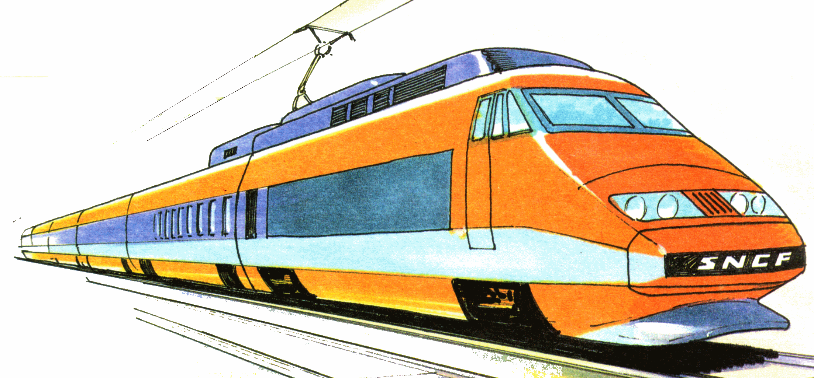
logic
You use logic to work out if something causes the results to be true or false. (Valid reasoning-taking all facts into consideration)
For example – consider a decision you might make.
If I walk in front of a moving train I will die
I am human made of flesh and blood and is not designed to sustain a crash (TRUE)
Train is made of metal and constructed to withstand impact and stress (TRUE)
Train is heavy and travelling fast (TRUE)
(THEREFORE) My body is no match for the train
(SO LOGICALLY) I will be destroyed
There is only a true or false outcome: No real, maybe or slightly true.

Slide 7
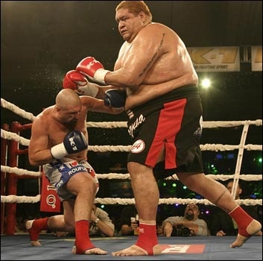
logic
Work out the logical conclusion of this situation:
Notes:
Work out all the true statements and facts about this and come up with a logical conclusion

Slide 8
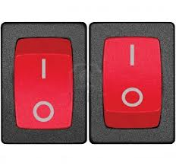
Which leads us onto: “Boolean”

Slide 9
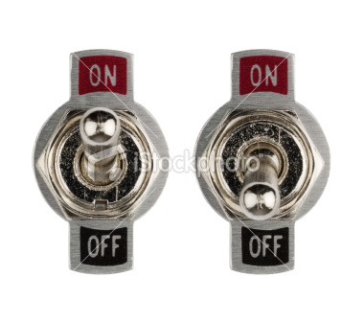
Which leads us onto: “Boolean”

Slide 10
Which leads us onto: “Boolean”

Slide 11
Which leads us onto: “Boolean”

Slide 12
Which leads us onto: “Boolean”

Slide 13
Which leads us onto: “Boolean”
How are you?

Slide 14
Progress check:
Boolean – describe it to me:
Logic – describe it to me:
Notes:
What makes a boolean

Slide 15
Research task -
Programming language | What is it? What is it used for?
Python
SQL
Visual Basic
HTML
Java
php

Slide 16
Progress check - feedback:
What have you come up with:

Slide 17
Programming computers
High level language
translator
Machine code

Slide 18
Lets extend...

