Slide 1
starter...

Slide 2
Program flow control
Come up with an example (programming) of when you might use the following building blocks: What would it do?
FOR loop
IF, THEN, ELSE
WHILE LOOP
Iteration, repetition, loop
Selection
Notes:
For loop – looping through words or lists performing tasks on each
IF, THEN ELSE statement -

Slide 3
3.1.3 Program Flow control_4
Structured programming –
Flowcharts

Slide 4
Lesson outcomes
Understand how problems can be broken down into smaller problems and how these steps can be represented by the use of devices such as flowcharts + structure diagrams
Be able to read and interpret a flow chart.
Be able to explain the meaning of: Block, derived, top down design.

Slide 5
Warm up...tell me a story
?
!=10 ?
true
false
Notes:
What would you call this?

Slide 6
Warm up...tell me a story

Slide 7
Task 1
Can you read
a flow chart?
What is this?
Notes:
Can you tell me the story of what is happening in this flow chart...?
Label: Selection, Iteration, Sequence

Slide 8
Some Vocab:
Some other terms that you may

Slide 9
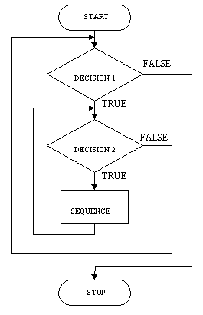
Nested constructs
Sometimes you have to use constructs together
Notes:
Input and output
http://users.evtek.fi/~jaanah/IntroC/DBeech/3gl_flow.htm

Slide 10
Program Control Flowcharts
Introducing a new block
Notes:
Input and output

Slide 11
Block structure
Using the building blocks
Enclosed structures between key words such as an IF statement
IF (Pay < £10K)
Tax Rate = 0%
IF (Pay > £40K)
Tax Rate = 40%
ELSE
Tax Rate = 20%
END IF
CASE Pay OF
<£10: THEN Tax Rate = 0%
<£40: THEN Tax Rate = 20%
<£150: THEN Tax Rate = 40%
>£150: THEN Tax Rate = 50%
END CASE

Slide 12
Top Down Design
What does this mean?

Slide 13
Iteration in another context

Slide 14
QUICK TASK! - Using loops in Scratch
Open scratch –
Create a loop for a shape that will move until it reaches something (such as bump into something) or fulfils some condition.

Slide 15
Homework challenge:
Rock, paper, scissors.
Produce a flow chart and psuedocode for a game of Rock, Paper scissors.

